Slide 1
Final Presentation
王浩哲 522072910008

Slide 2
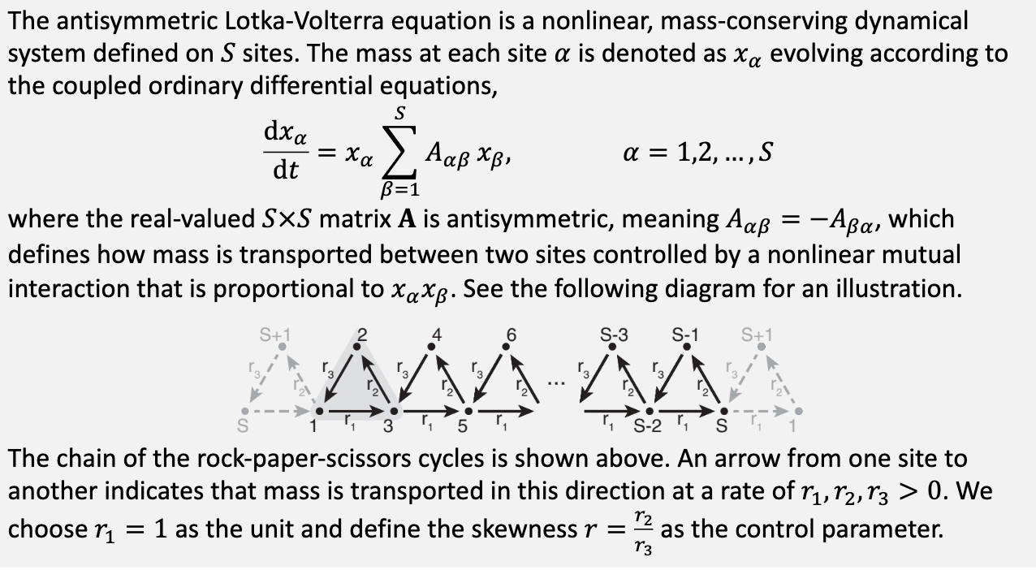

Problem 1 .1

Slide 3
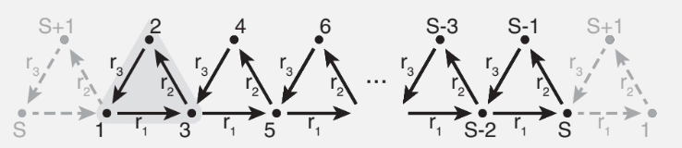
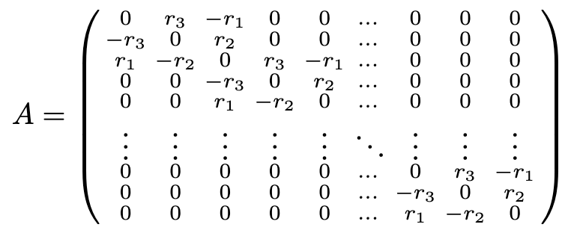
Problem 1 .1

Slide 4
Problem 1 .1 Code
import numpy as np
import matplotlib.pyplot as plt
# Constants
S = 13
r_1 = 1.0
r_2 = 0.5 # 0.5 for Problem 1.1, 1.0 for Problem 1.2, 2.0 for Problem 1.3
r_3 = 1.0
a = 0.0
b = 5000.0
h = 0.1
# Generate matrix A
first_diag = np.zeros(S - 1)
second_diag = np.zeros(S - 2)
for i in range(S - 2):
if i % 2 == 1:
first_diag[i] = r_2
second_diag[i] = 0
else:
first_diag[i] = r_3
second_diag[i] = -r_1
first_diag[-1] = r_2
A = (
np.diag(first_diag, k=1)
+ np.diag(second_diag, k=2)
+ np.diag(-first_diag, k=-1)
+ np.diag(-second_diag, k=-2)
)
# Initial conditions
x_alpha = np.zeros(S)
for alpha in range(S):
if alpha % 2 == 1:
x_alpha[alpha] = (2 - 0.01 * (S + 1)) / (S - 1)
else:
x_alpha[alpha] = 0.01
# ALVE
def f(x_, A_):
f_ = np.zeros(S)
for i in range(S):
f_[i] = x_[i] * np.dot(A_[i], x_)
return f_

Slide 5
Problem 1 .1 Code
# Runga-Kutta method
def rk4(x_, A_, h):
k1 = h * f(x_, A_)
k2 = h * f(x_ + 0.5 * k1, A_)
k3 = h * f(x_ + 0.5 * k2, A_)
k4 = h * f(x_ + k3, A_)
return x_ + (k1 + 2 * k2 + 2 * k3 + k4) / 6
# Time evolution
tpoints = np.arange(a, b, h)
xpoints = np.zeros((S, tpoints.shape[0]))
for t in range(tpoints.shape[0]):
xpoints[:, t] = x_alpha
x_alpha = rk4(x_alpha, A, h)
# Plot 2D
plt.figure(dpi=300)
plt.plot(tpoints, xpoints[12], label=r"$x_{13}$", linewidth=0.5)
plt.plot(tpoints, xpoints[5], label=r"$x_{6}$", linewidth=0.5)
plt.plot(tpoints, xpoints[0], label=r"$x_{1}$", linewidth=0.5)
plt.xlabel("Time")
plt.title(f"Mass Evolutions (skewness = {r_2})")
plt.legend()
plt.grid()
plt.savefig(f"./Graph/mass_evolutions_{r_2}.png")
plt.show()

Slide 6
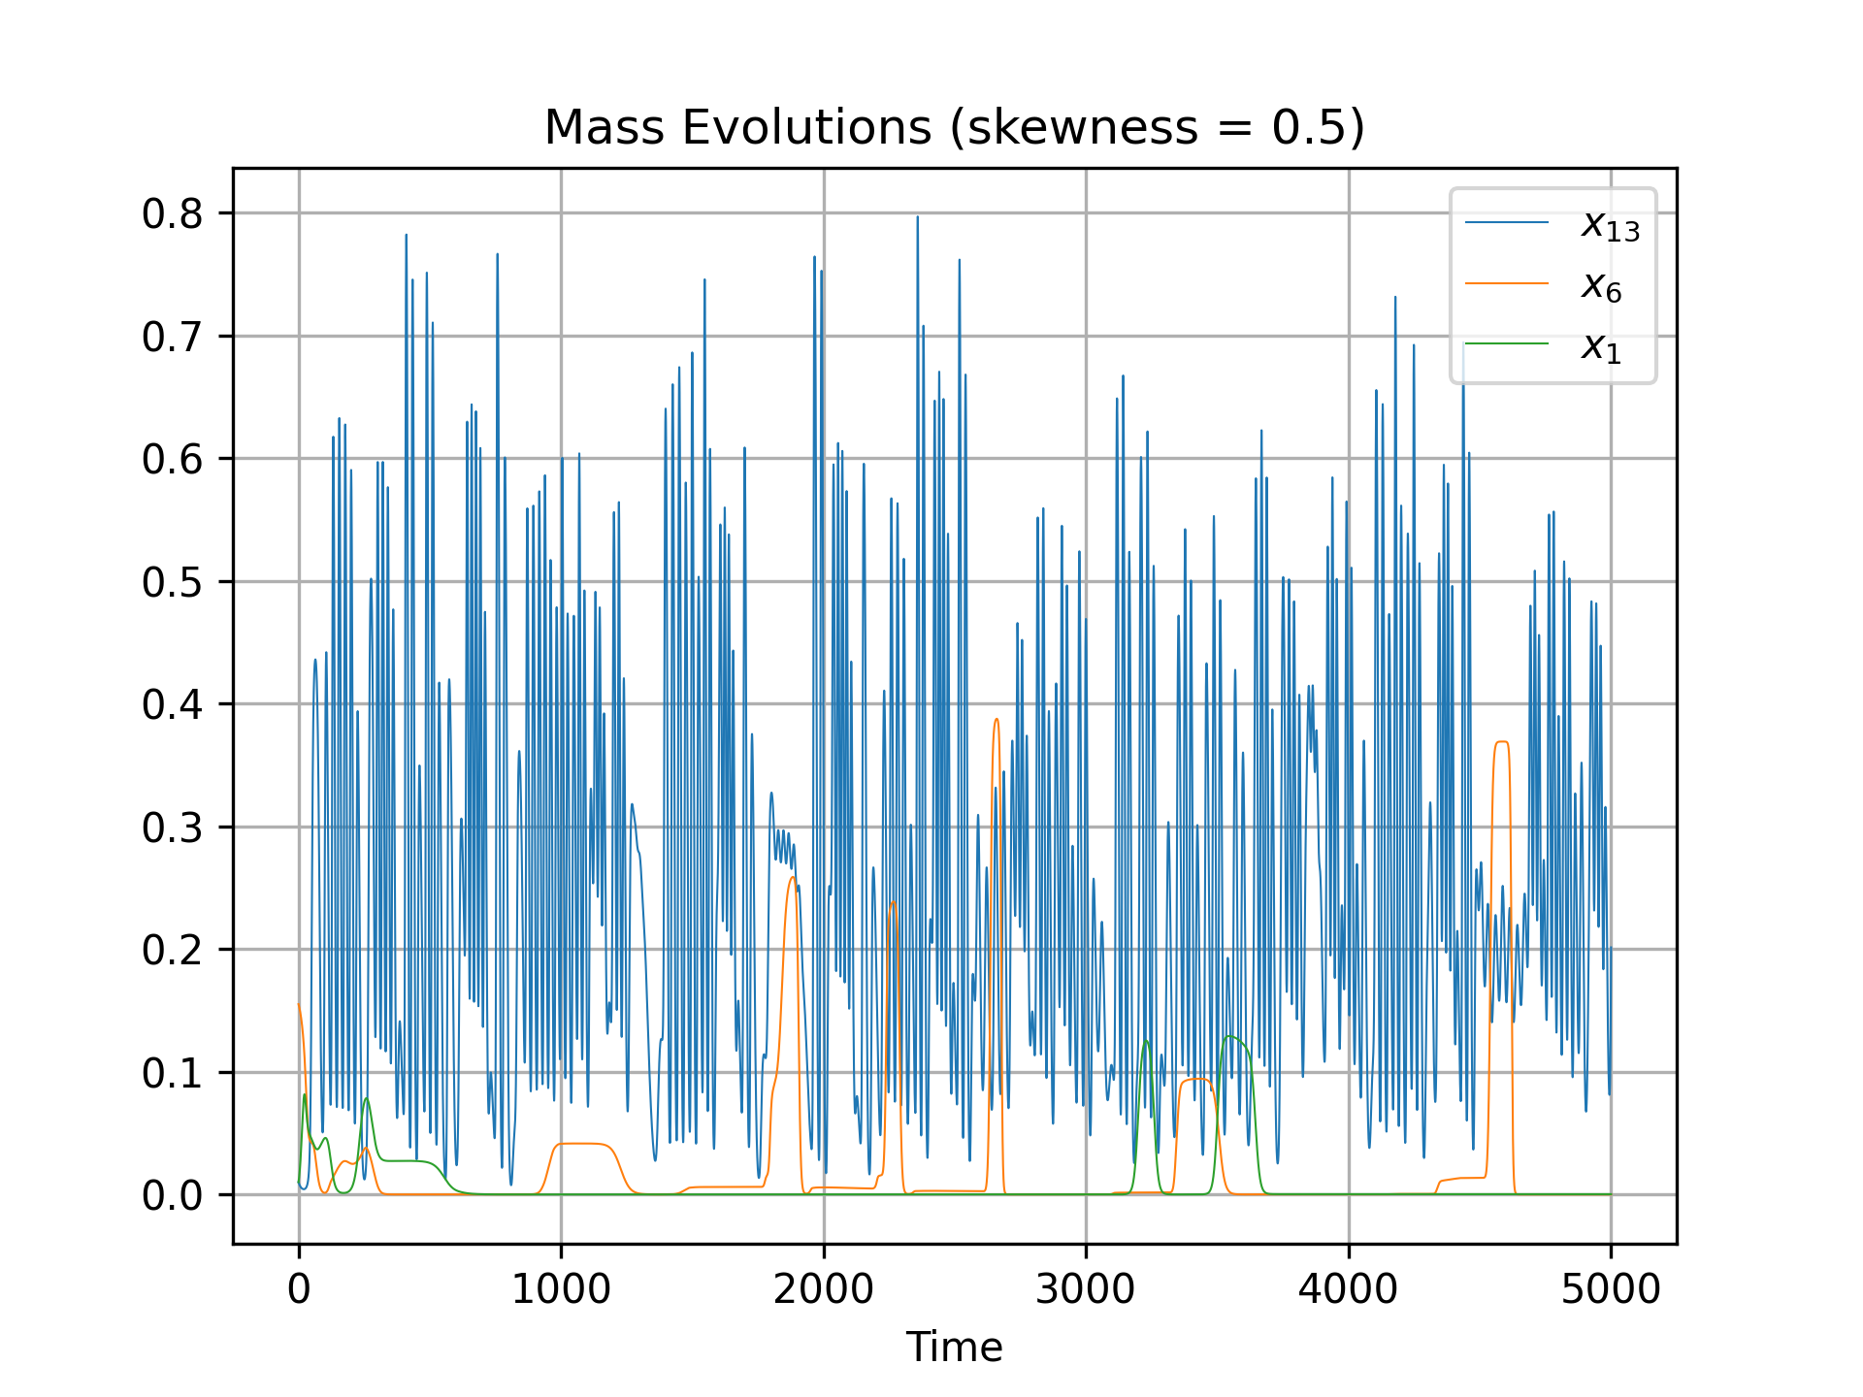
Problem 1 .1 Result

Slide 7
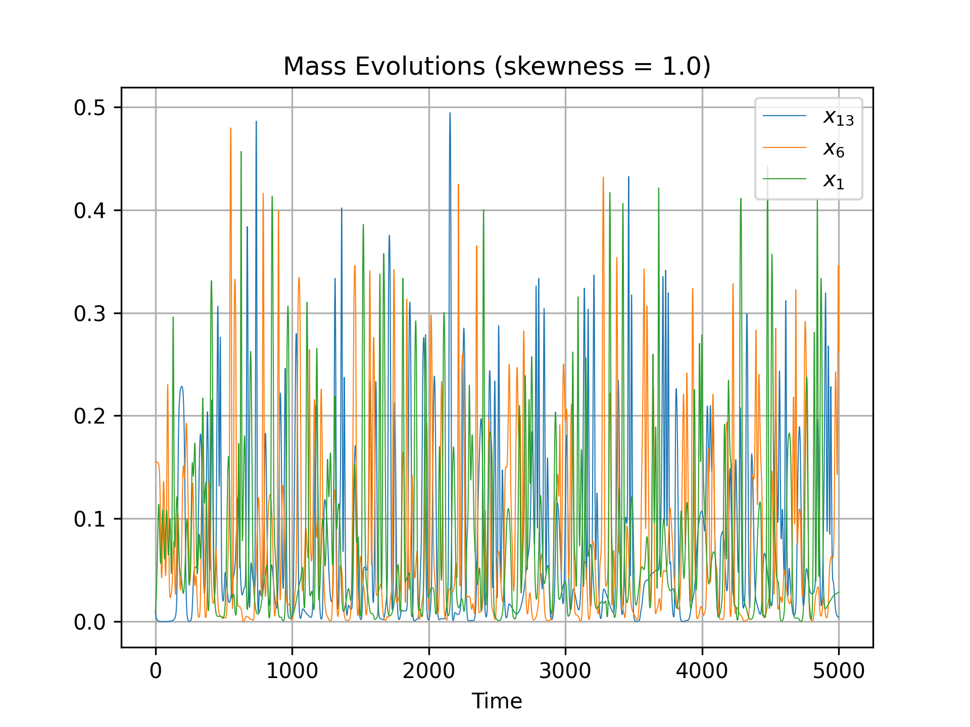
Problem 1 .2 Result

Slide 8
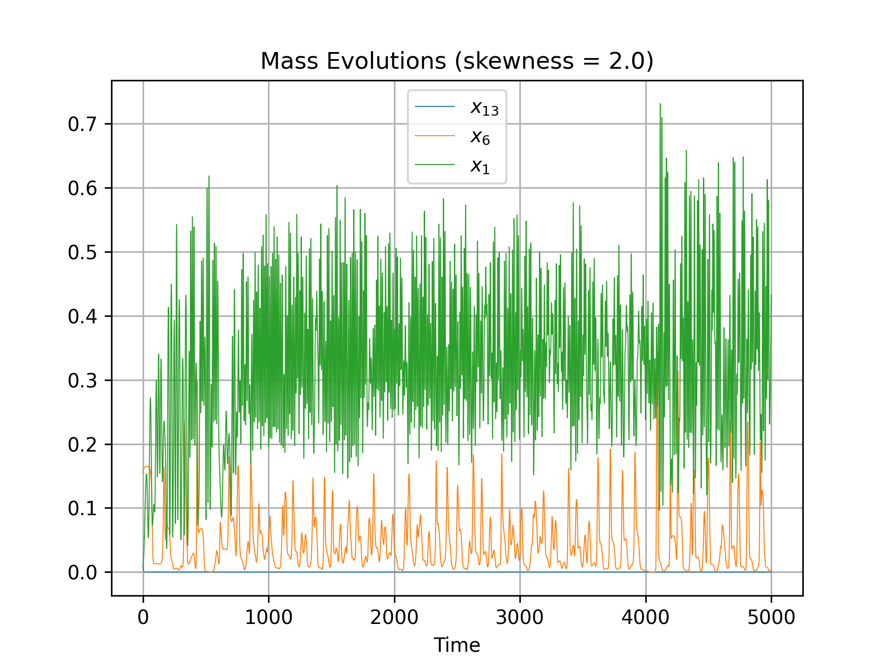
Problem 1 .3 Result

Slide 9
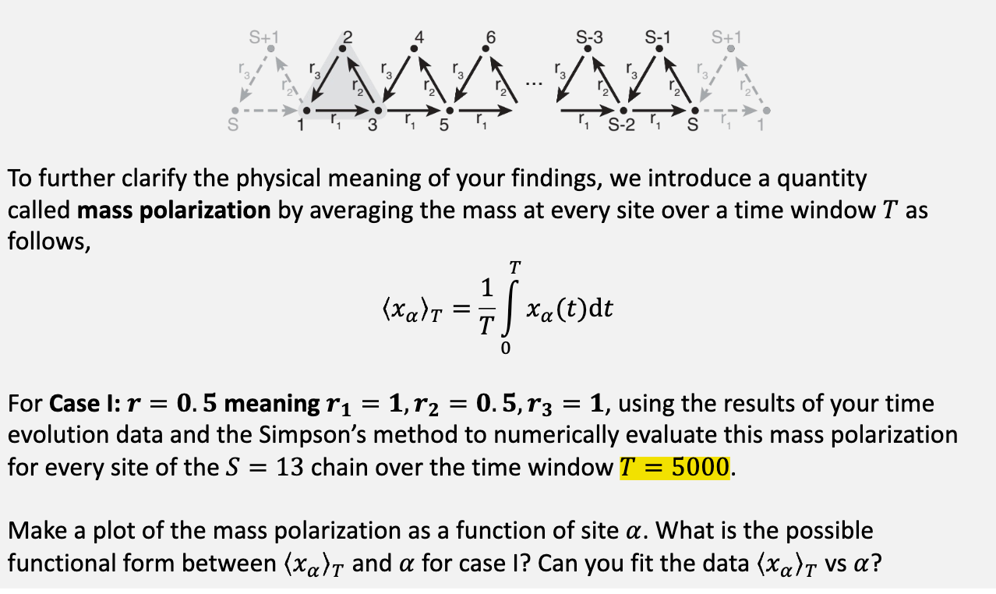
Problem 1 .4

Slide 10
Problem 1 .4 Code
# Polarization
def simpson(x_, a_, b_, h_):
return (np.sum(x_[1:-1:2] * 4 + x_[2:-1:2] * 2) + x_[0] + x_[-1]) * h_ / 3
x_average = np.zeros(S)
for alpha in range(S):
x_average[alpha] = simpson(xpoints[alpha, :], a, b, h) / (b - a)
alpha = np.arange(1, S + 1, 1)
# Fit
def fit_func(x, a, b):
if r_2 == 1.0:
return a
else:
return a * np.exp(b * x)
popt, pcov = curve_fit(fit_func, alpha, x_average)
# Plot 2D
plt.figure(dpi=300)
plt.plot(alpha, x_average, label=r"$\langle x_{\alpha} \rangle _{T}$")
if r_2 == 1.0:
plt.plot(
alpha,
popt[0] * np.ones_like(alpha),
label="Fitted Curve($" + str(round(popt[0], 3)) + "$)",
)
else:
plt.plot(
alpha,
fit_func(alpha, *popt),
label="Fitted Curve($"
+ str(round(popt[0], 3))
+ "\cdot e^{"
+ str(round(popt[1], 3))
+ "\cdot x}$)",
)
plt.xlabel(r"$\alpha$")
plt.ylabel(r"$\langle x_{\alpha} \rangle _{T}$")
plt.title(f"Mass Polarization (skewness = {r_2})")
plt.legend()
plt.grid()
plt.savefig(f"./Graph/mass_polarization_{r_2}.png")
plt.show()

Slide 11
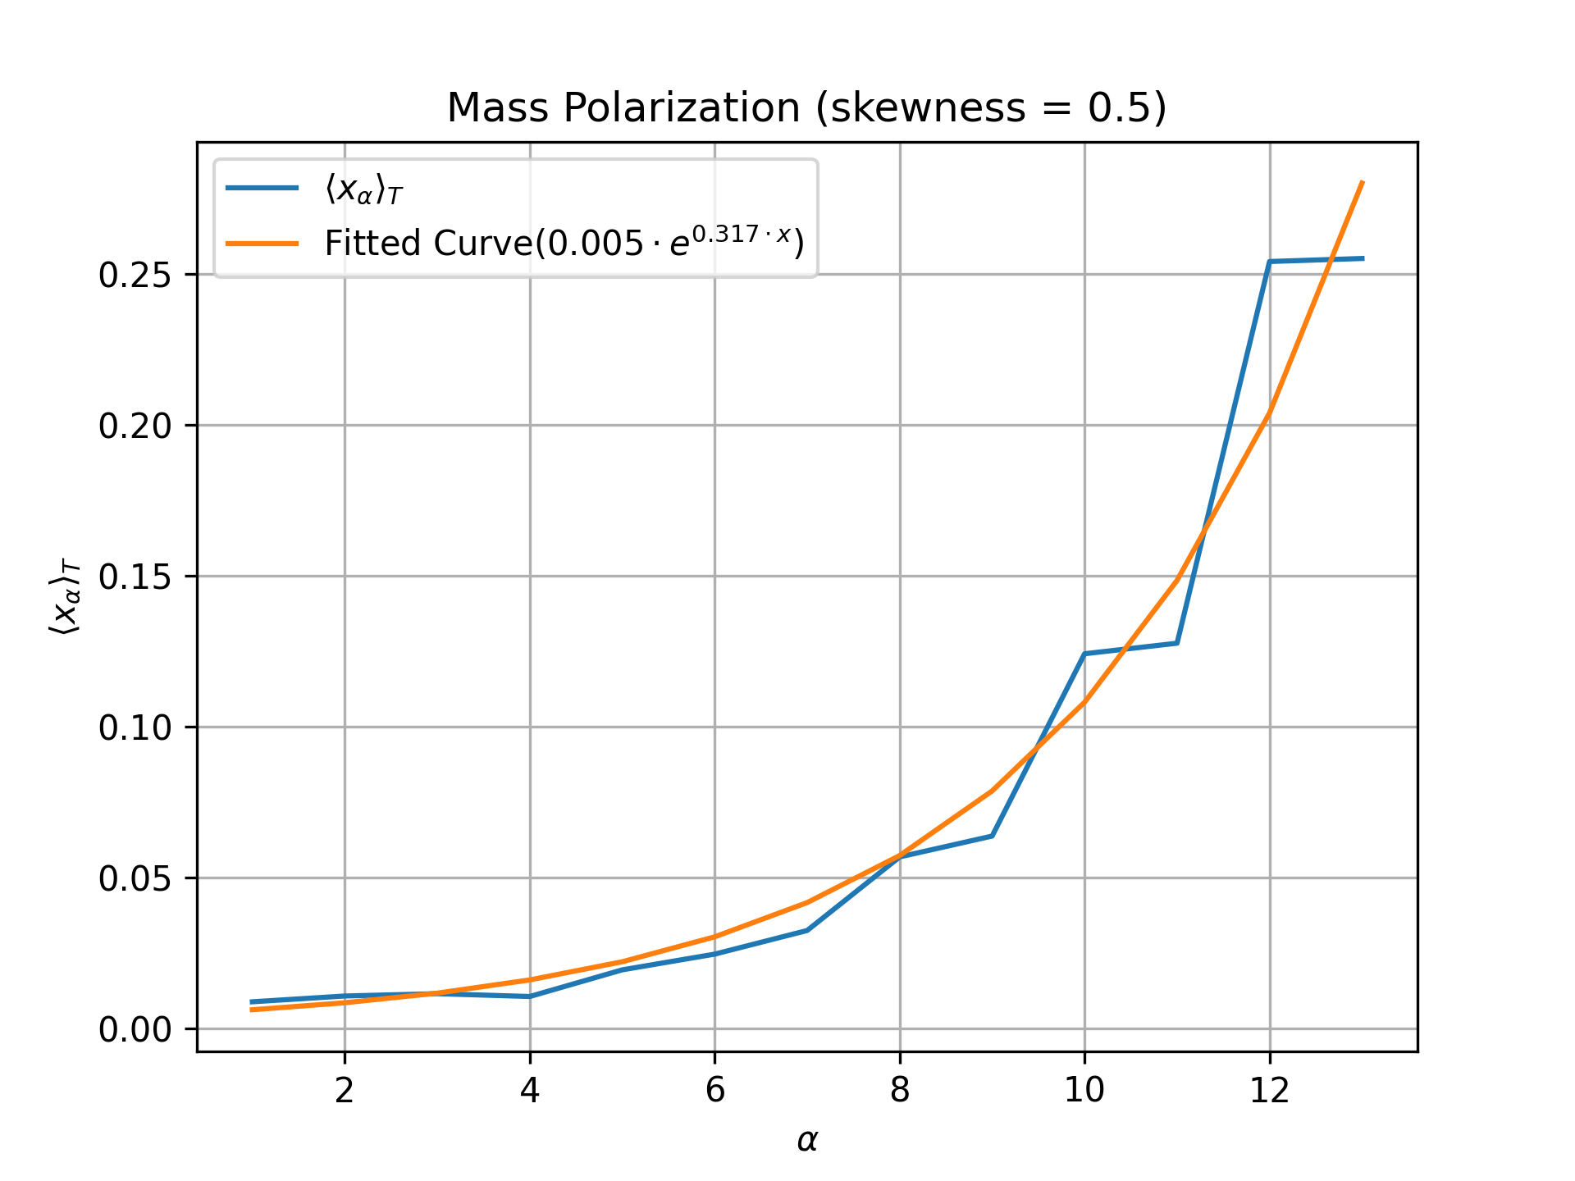
Problem 1 .4 Result

Slide 12
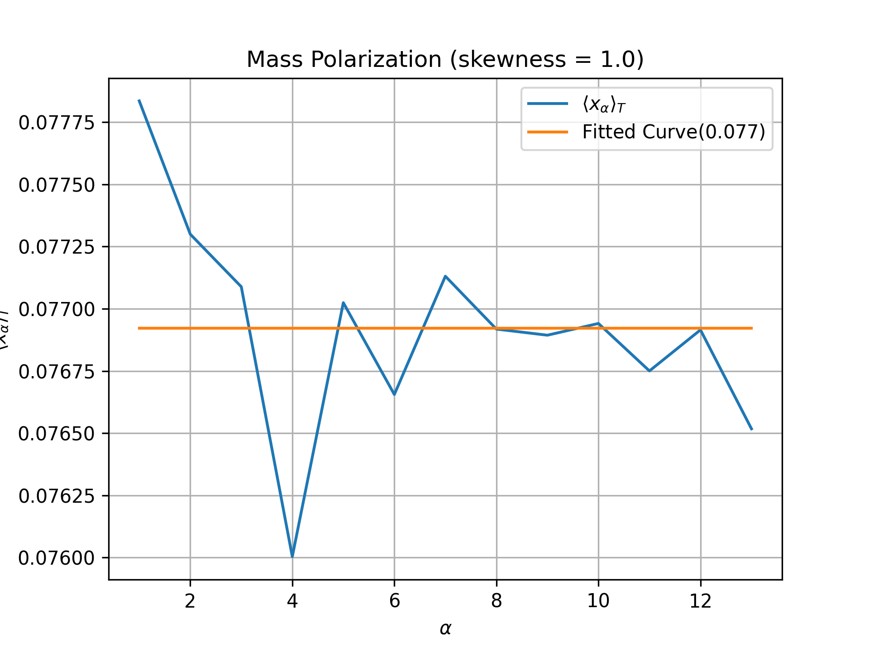
Problem 1 .5 Result

Slide 13
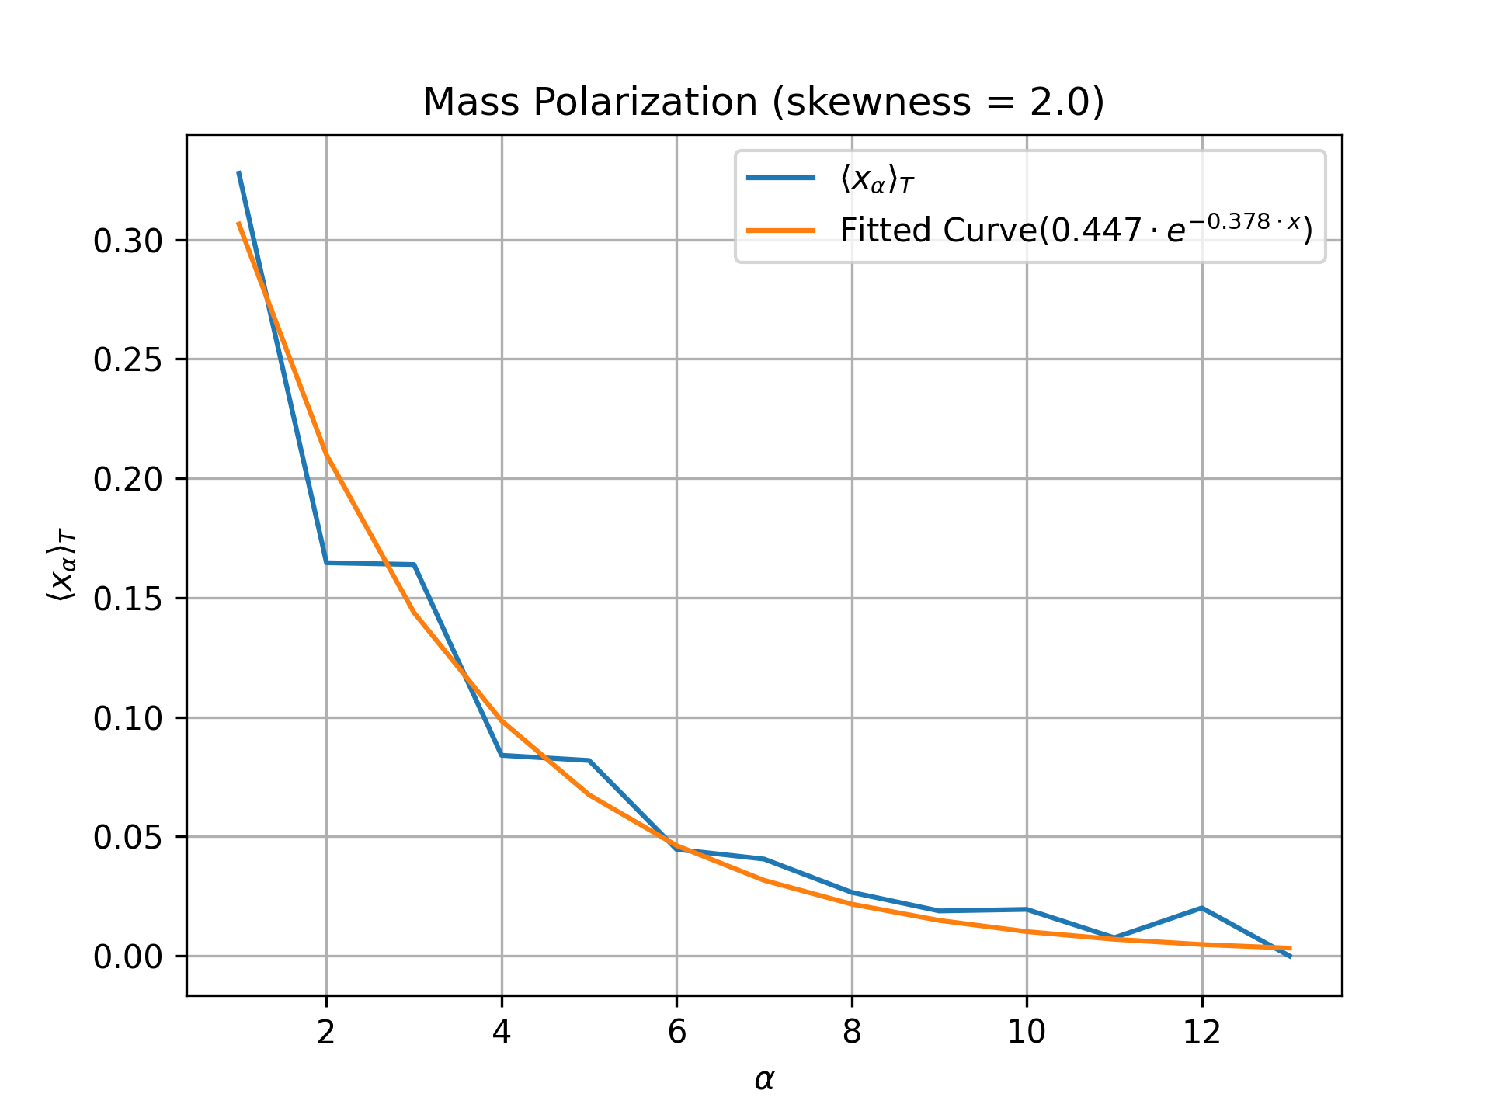
Problem 1 .6 Result

Slide 14
Problem 1 .7 Result
Yes, there is a topological phase transition.
For r<1, the mass is polarized to one boundary (right). For r>1, the mass is polarized to the other boundary (left). For r=1, the average masses expand throughout the whole chain, marking the transition point between the two polarization.

Slide 15
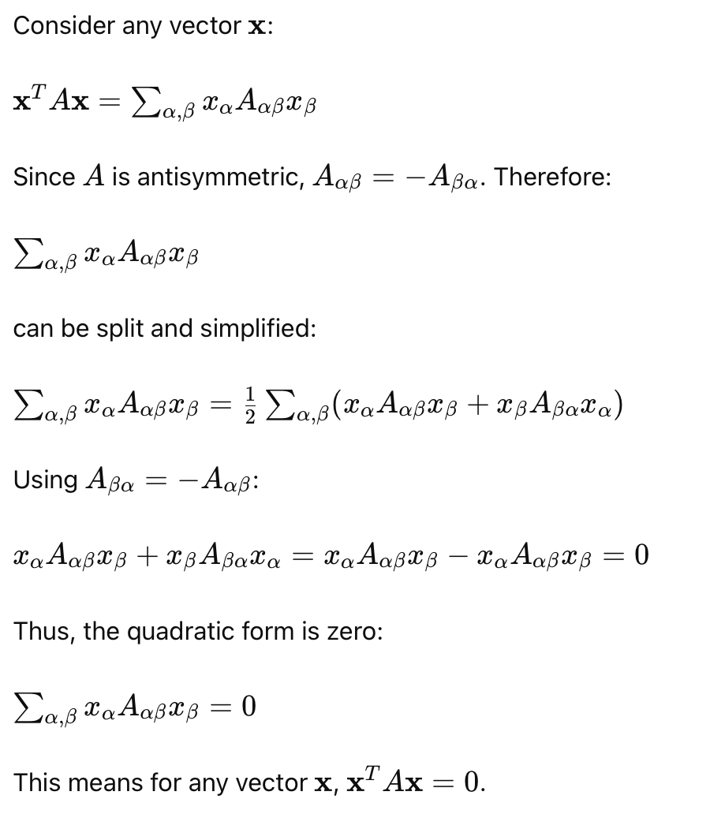
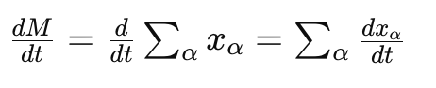
Problem 1 .7 Result
= 0
The total mass of the chain is conserved.

Slide 16
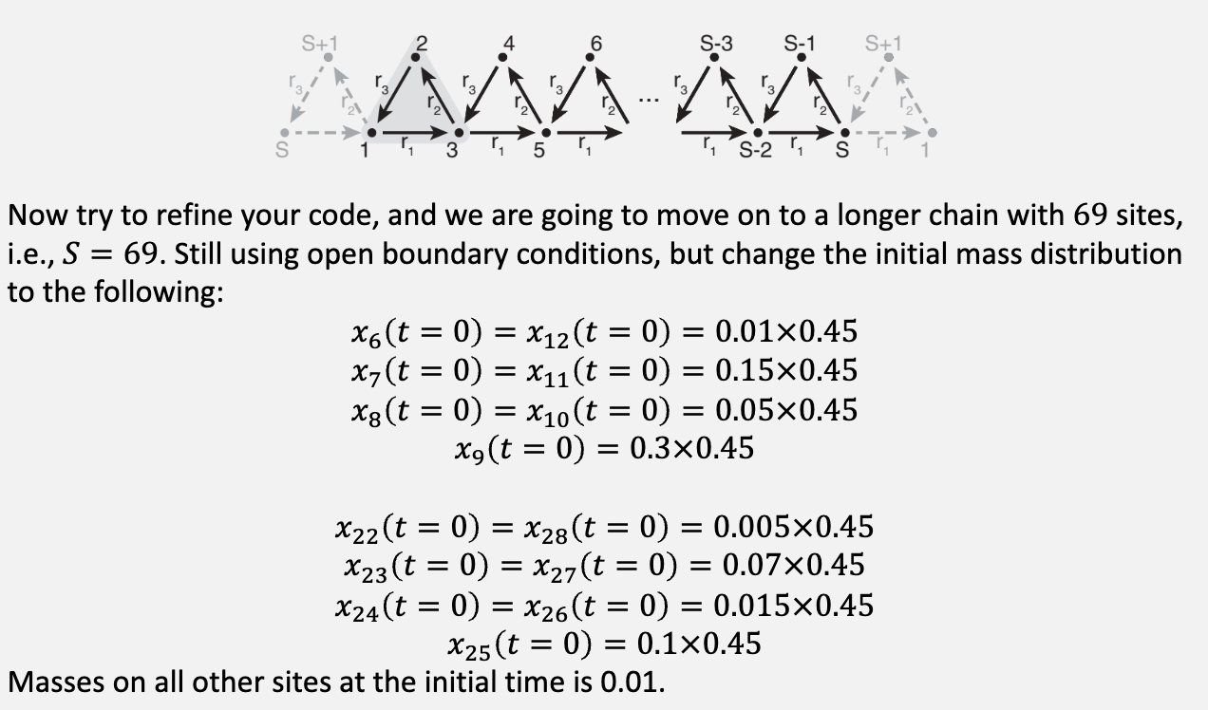
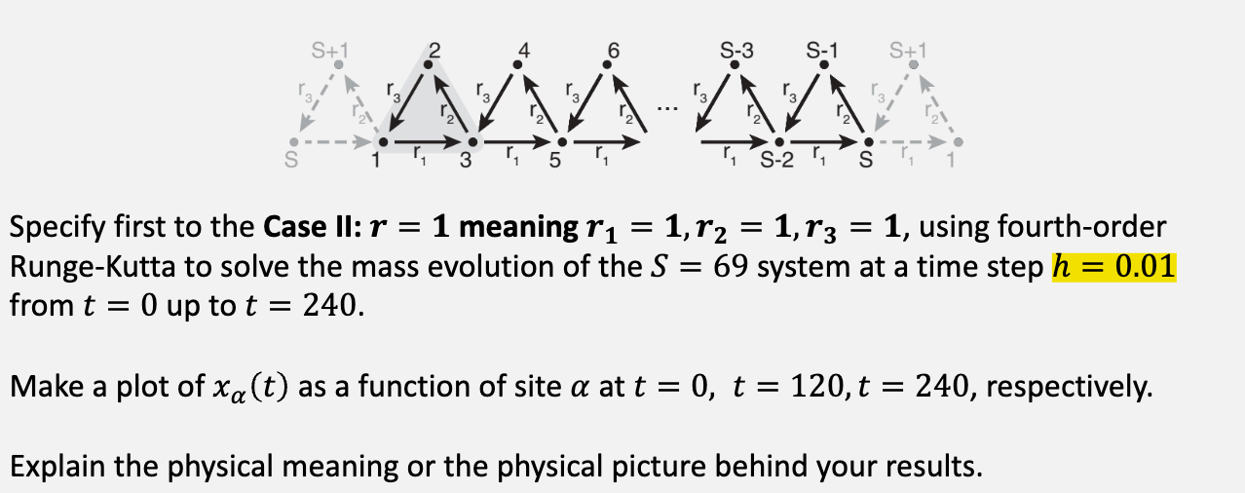
Problem 1 .8

Slide 17
Problem 1 .8 Code
# Initial conditions
x_alpha = np.full((S,), 0.01)
x_alpha[5] = x_alpha[12] = 0.01 * 0.45
x_alpha[6] = x_alpha[10] = 0.15 * 0.45
x_alpha[7] = x_alpha[9] = 0.05 * 0.45
x_alpha[8] = 0.3 * 0.45
x_alpha[21] = x_alpha[27] = 0.005 * 0.45
x_alpha[22] = x_alpha[26] = 0.07 * 0.45
x_alpha[23] = x_alpha[25] = 0.015 * 0.45
x_alpha[24] = 0.1 * 0.45
...
# Plot 3D
fig = plt.figure(dpi=300)
ax = fig.add_subplot(projection="3d")
for i in [240, 180, 120, 60, 1]:
ax.plot(alpha, i * np.ones(S), xpoints[:, int(i / h - 1)])
ax.set_xlabel(r"$\alpha$")
ax.set_ylabel("Time")
ax.set_zlabel(r"$x_{\alpha}$")
ax.set_yticks([1, 60, 120, 180, 240])
plt.title(f"Solitary Wave (skewness = {r_2})")
plt.savefig(f"./Graph/solitary_waves_{r_2}.png")

Slide 18
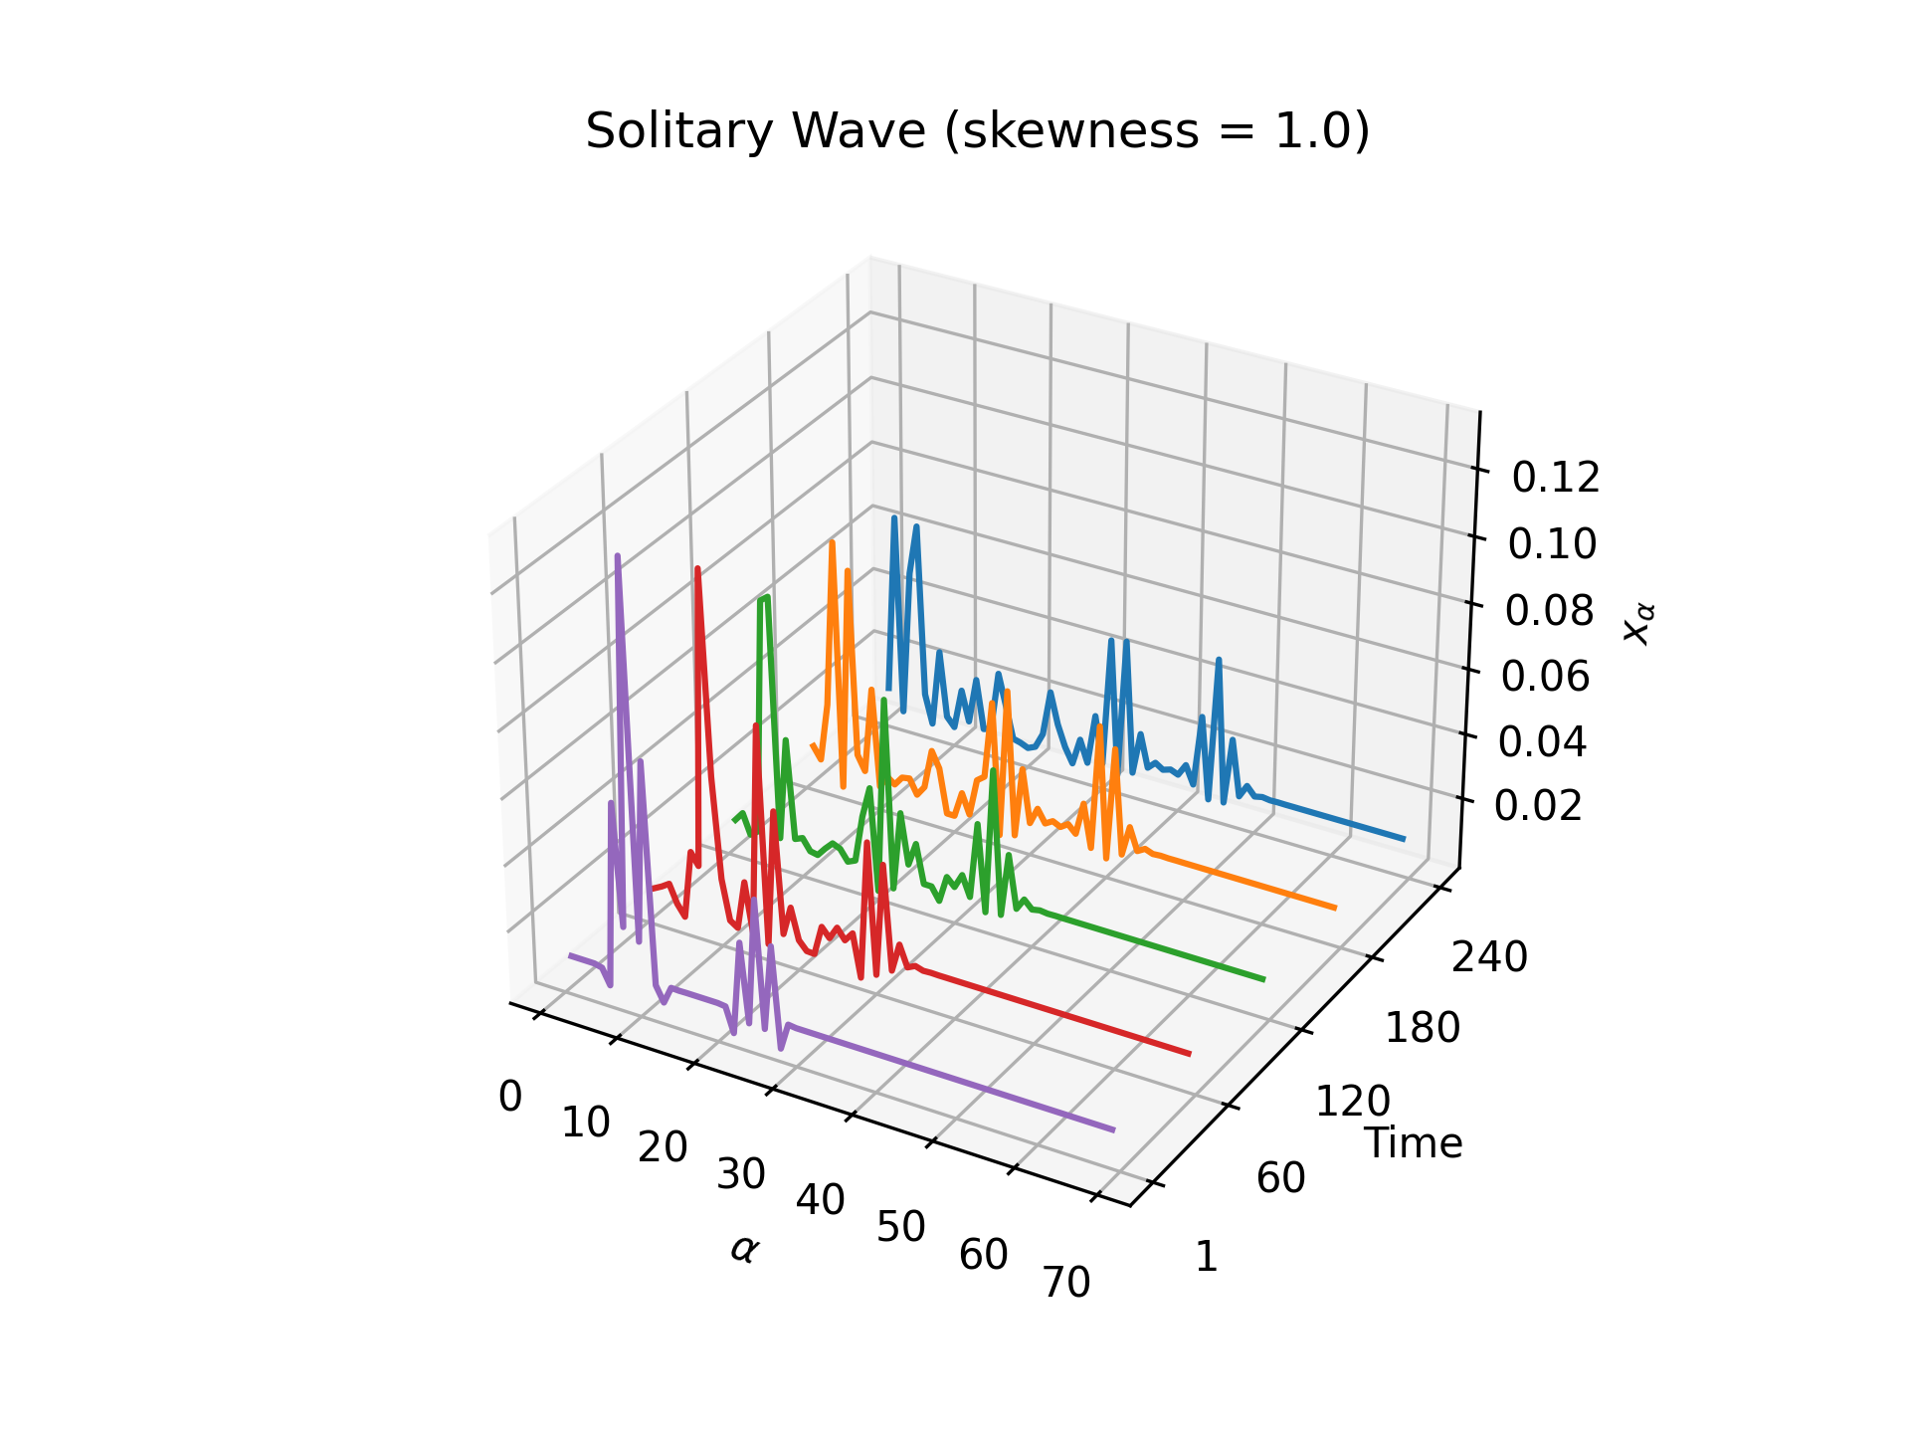
Problem 1 .8 Result
It is a rightward-propagating wave.

Slide 19
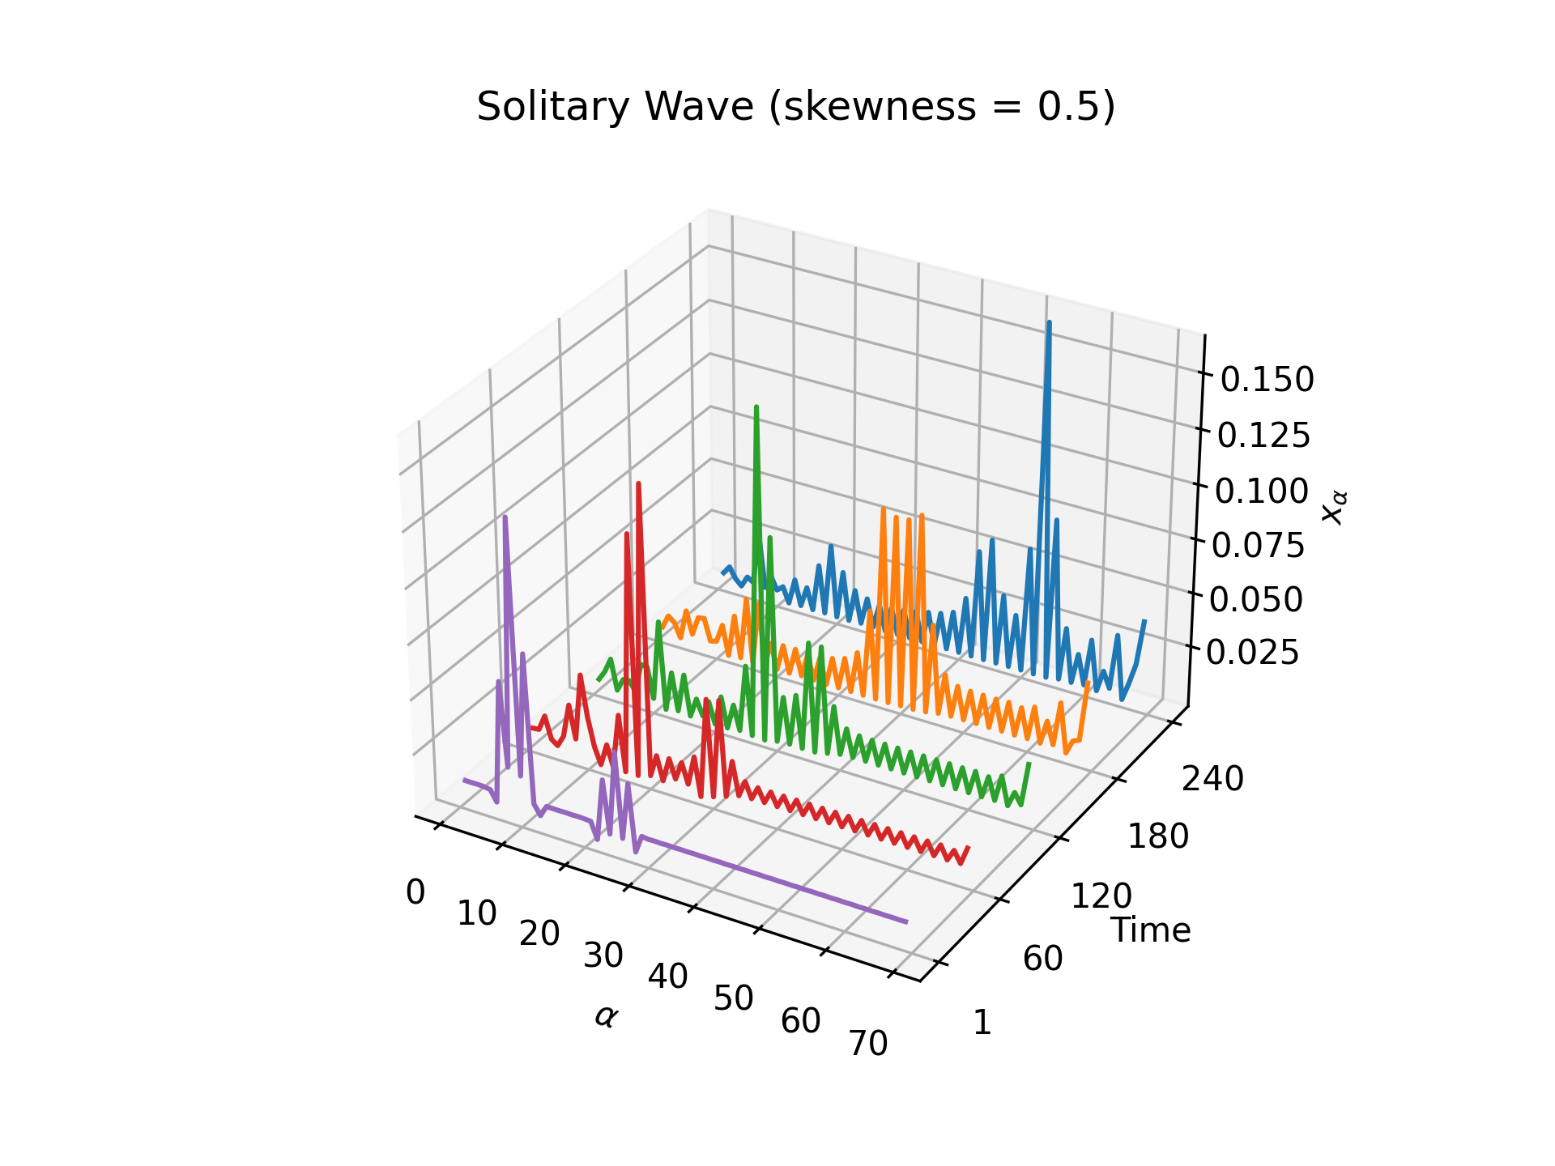
Problem 1 .9 Result
It is a rightward-propagating wave (faster than Case II).

Slide 20
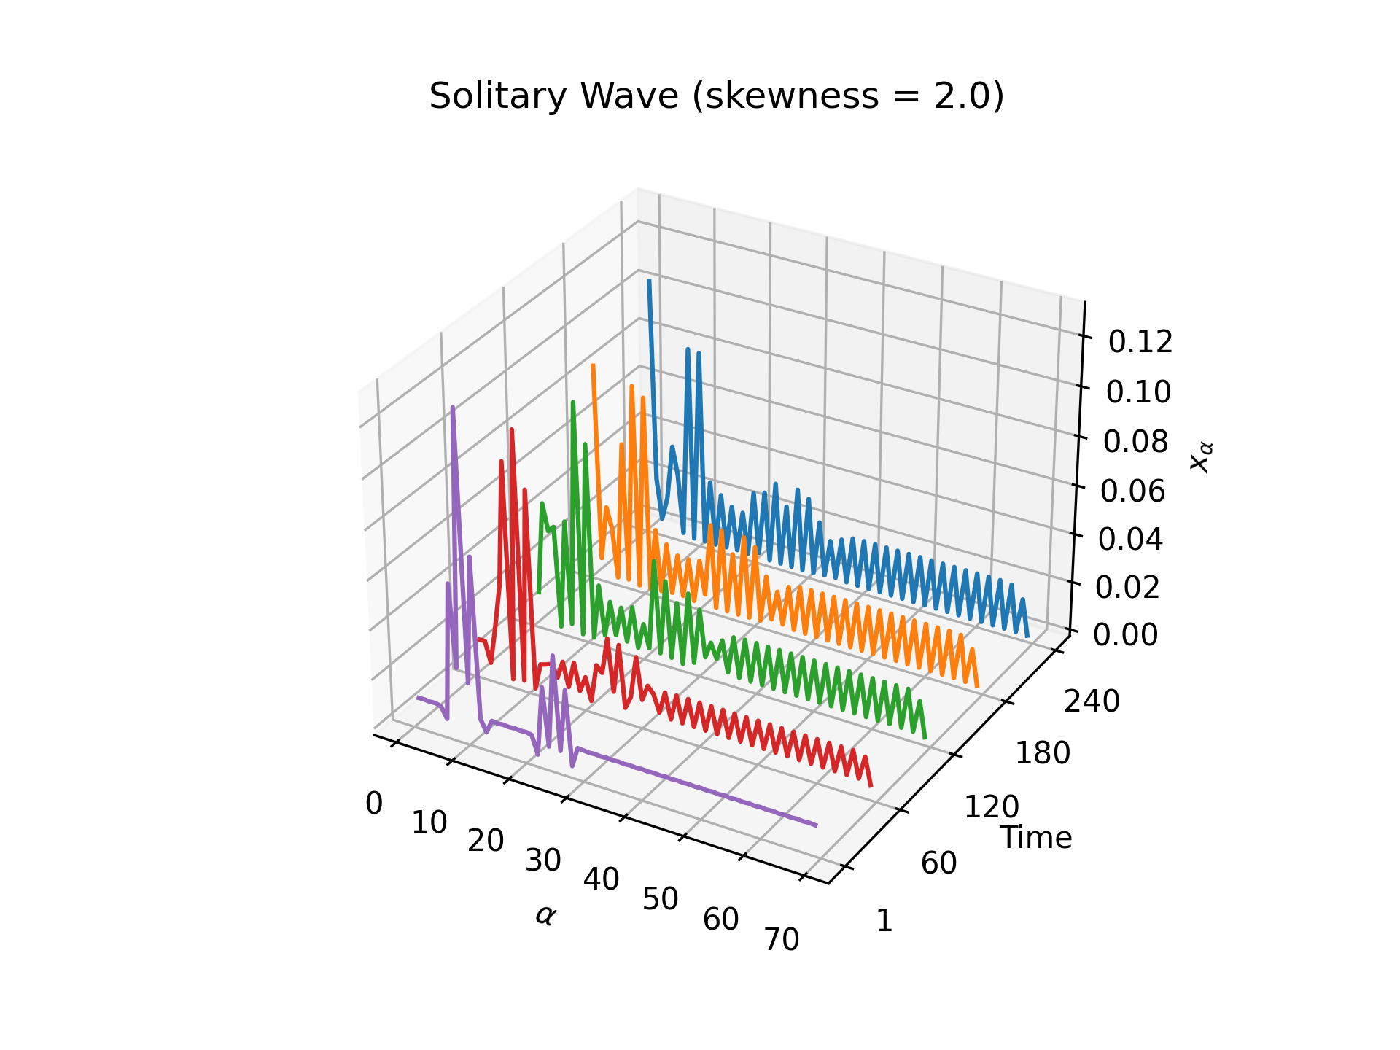
Problem 1 .10 Result
It is a leftward-propagating wave.

